Slide 1
Preparing for EDAC’s Ec.D. Certification
Economic Developers | We’re certifiable.

Slide 2
The Certified Economic Developer (Ec.D.) is the Canadian economic development profession`s only international certification mark.
It represents a commitment to the highest standards of practice in economic development and adherence to the national Code of Ethics of the profession and the Economic Developers Association of Canada.

Slide 3
Why Become Certified
Economic development is a complex, multi-dimensional process
General proficiency in economic development
Municipalities are requesting Ec.D. in job postings
Increased employability
Increased wages

Slide 4
Requirements to Apply
EDAC member in good standing
Three years economic development experience
45 points (training credits)
Completion of exam (75% pass mark)
Re-certification every 3 years
Notes:
!

Slide 5
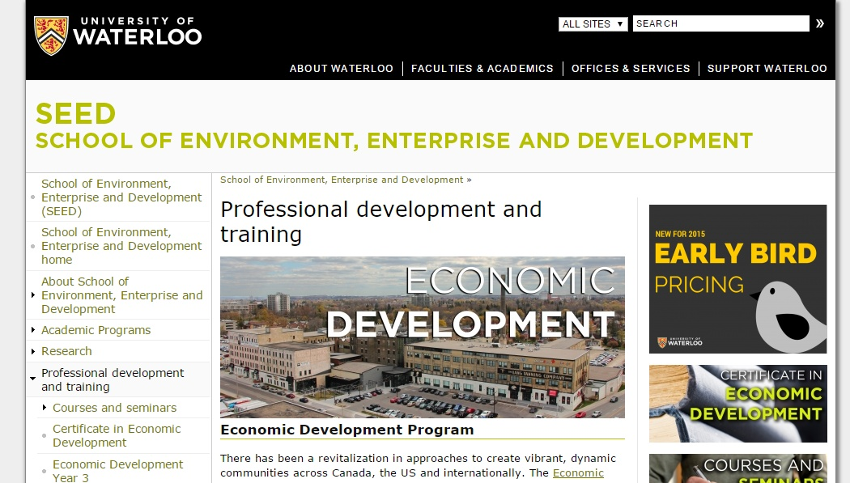
University of Waterloo
Year 1 and Year 2 University of Waterloo program
Certificate in Economic Development
Diploma in Economic Development

Slide 6
University of Calgary
Certificate in Professional Management

Slide 7
Dalhousie and Cape Breton University

Slide 8
The Points Add Up
Conferences
Relevant degree (Undergraduate or graduate degree)
Various courses
CEDTP courses
University of Waterloo seminars
Provincial & Territorial seminars
When in doubt, contact EDAC

Slide 9
What to Expect on the Exam
Five hours of…
Oral Portion
Multiple Choice Portion
Contemporary Essay
8 short essays to test Core Competencies

Slide 10
Core Skills for an Economic Developer
Economic development processes
Governance
Operations
Communications
Planning
Marketing and sales
Finance

Slide 11
Getting Ready
Practical experience/lessons learned on the job
Review lessons learned
Year 1/Year 2 Waterloo
CEDTP
Other accredited courses & seminars/training
Understanding current affairs and their impact on your community/region
The Essentials of Economic Development: Practices, Principles and Planning

Slide 12
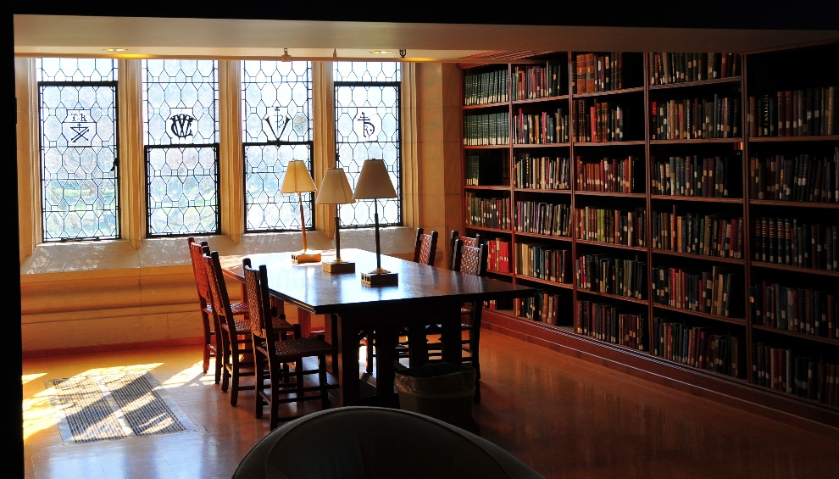
How to Prepare
Be in the right mindset
Study, study, study
Find a good time and place to write the exam (coordinate with EDAC)

Slide 13
Grading the Exam
Exams are graded by a panel
Results are confidential
Rewrites are available
Successful candidates awarded certification at annual EDAC conference

Slide 14
Benefits of the Ec.D.
The Ec.D. is Canada's nationally-recognized certification
Members who have earned the Ec.D. Designation are highly sought after in our field. Increasingly, the Ec.D. is being included as a requirement for career opportunities in our national database. This designation, along with a requirement of re-certification every three years, ensures a uniform and professional basis for all Canadians employed in this field which is supported by industry and governments.
EDAC

Slide 15
Designation Matters
“As Economic Developers we should hold ourselves accountable to being educated in our industry so we can provide the best possible service and value to our communities.”
I wanted to ensure I was updating my education and activating on all opportunities provided to me by Economic Development organizations such as EDAC and EDA Alberta. I held myself accountable to becoming an educated and designated economic developer. I am proud of my designation and thankfully this was a determining factor to me receiving my current job position.
Michelle Lavasseur, Ec.D. Leduc-Nisku Economic Development Association

Slide 16
A Recognized Designation

Slide 17
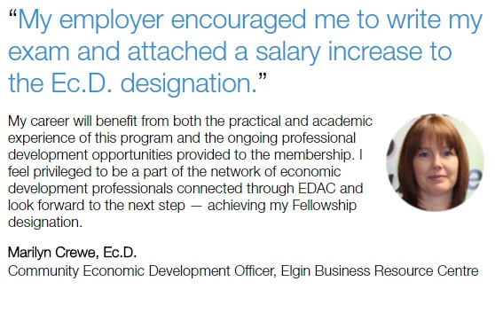
Designation Pays

Slide 18
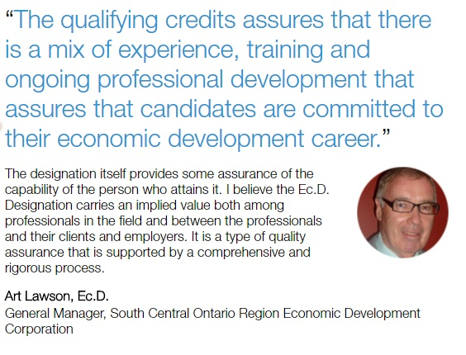
Assured Capabilities

Slide 19
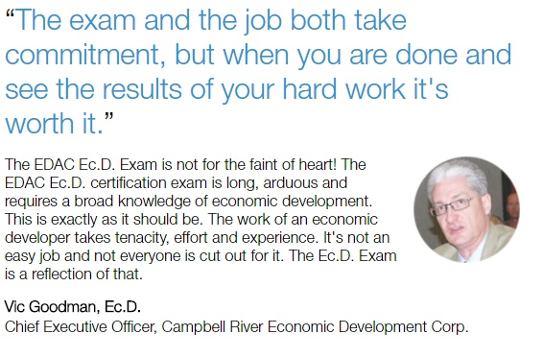
Commitment and Tenacity

Slide 20
Where could the Ec.D. professional certification take you?
To learn more about the certification process, please contact :
Larry Horncastle Ec.D., HLM Penny Gardiner, Ec.D.
Keystone Strategies Inc. EDAC CEO
larry@keystonestrategies.ca gardiner@edac.ca
www.keystonestrategies.ca www.edac.ca

