Slide 1
EDAC Annual Conference
Growing WITH your community: Managing Diverse views through public engagement
September 22, 2015

Slide 2
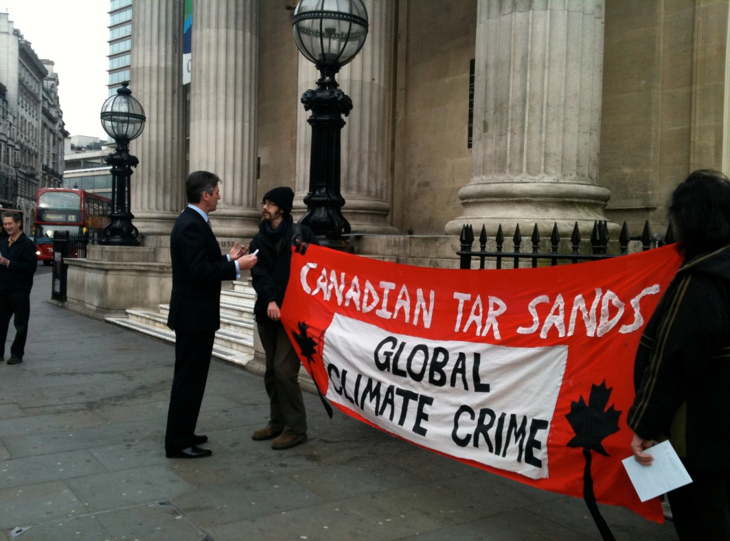
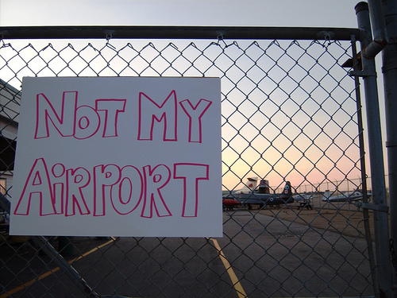
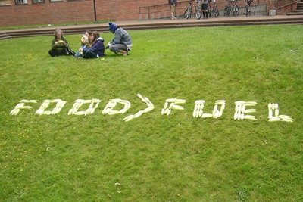
Experience & Lessons Learned
What to do & what not to do
Examples

Slide 3
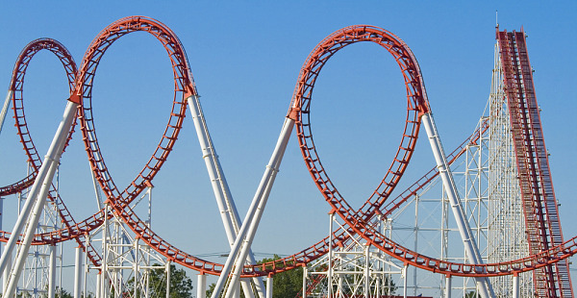
Question your Assumptions

Slide 4
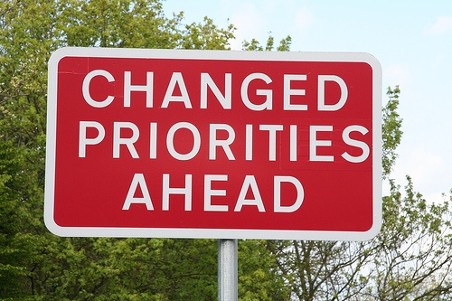

Slide 5
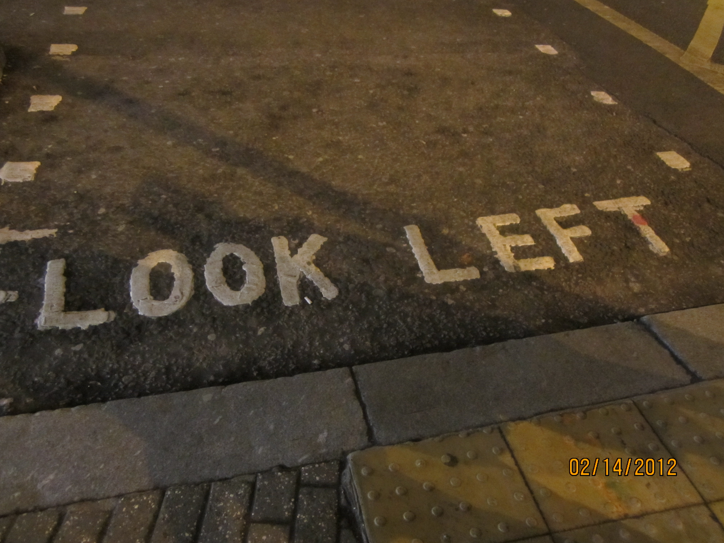
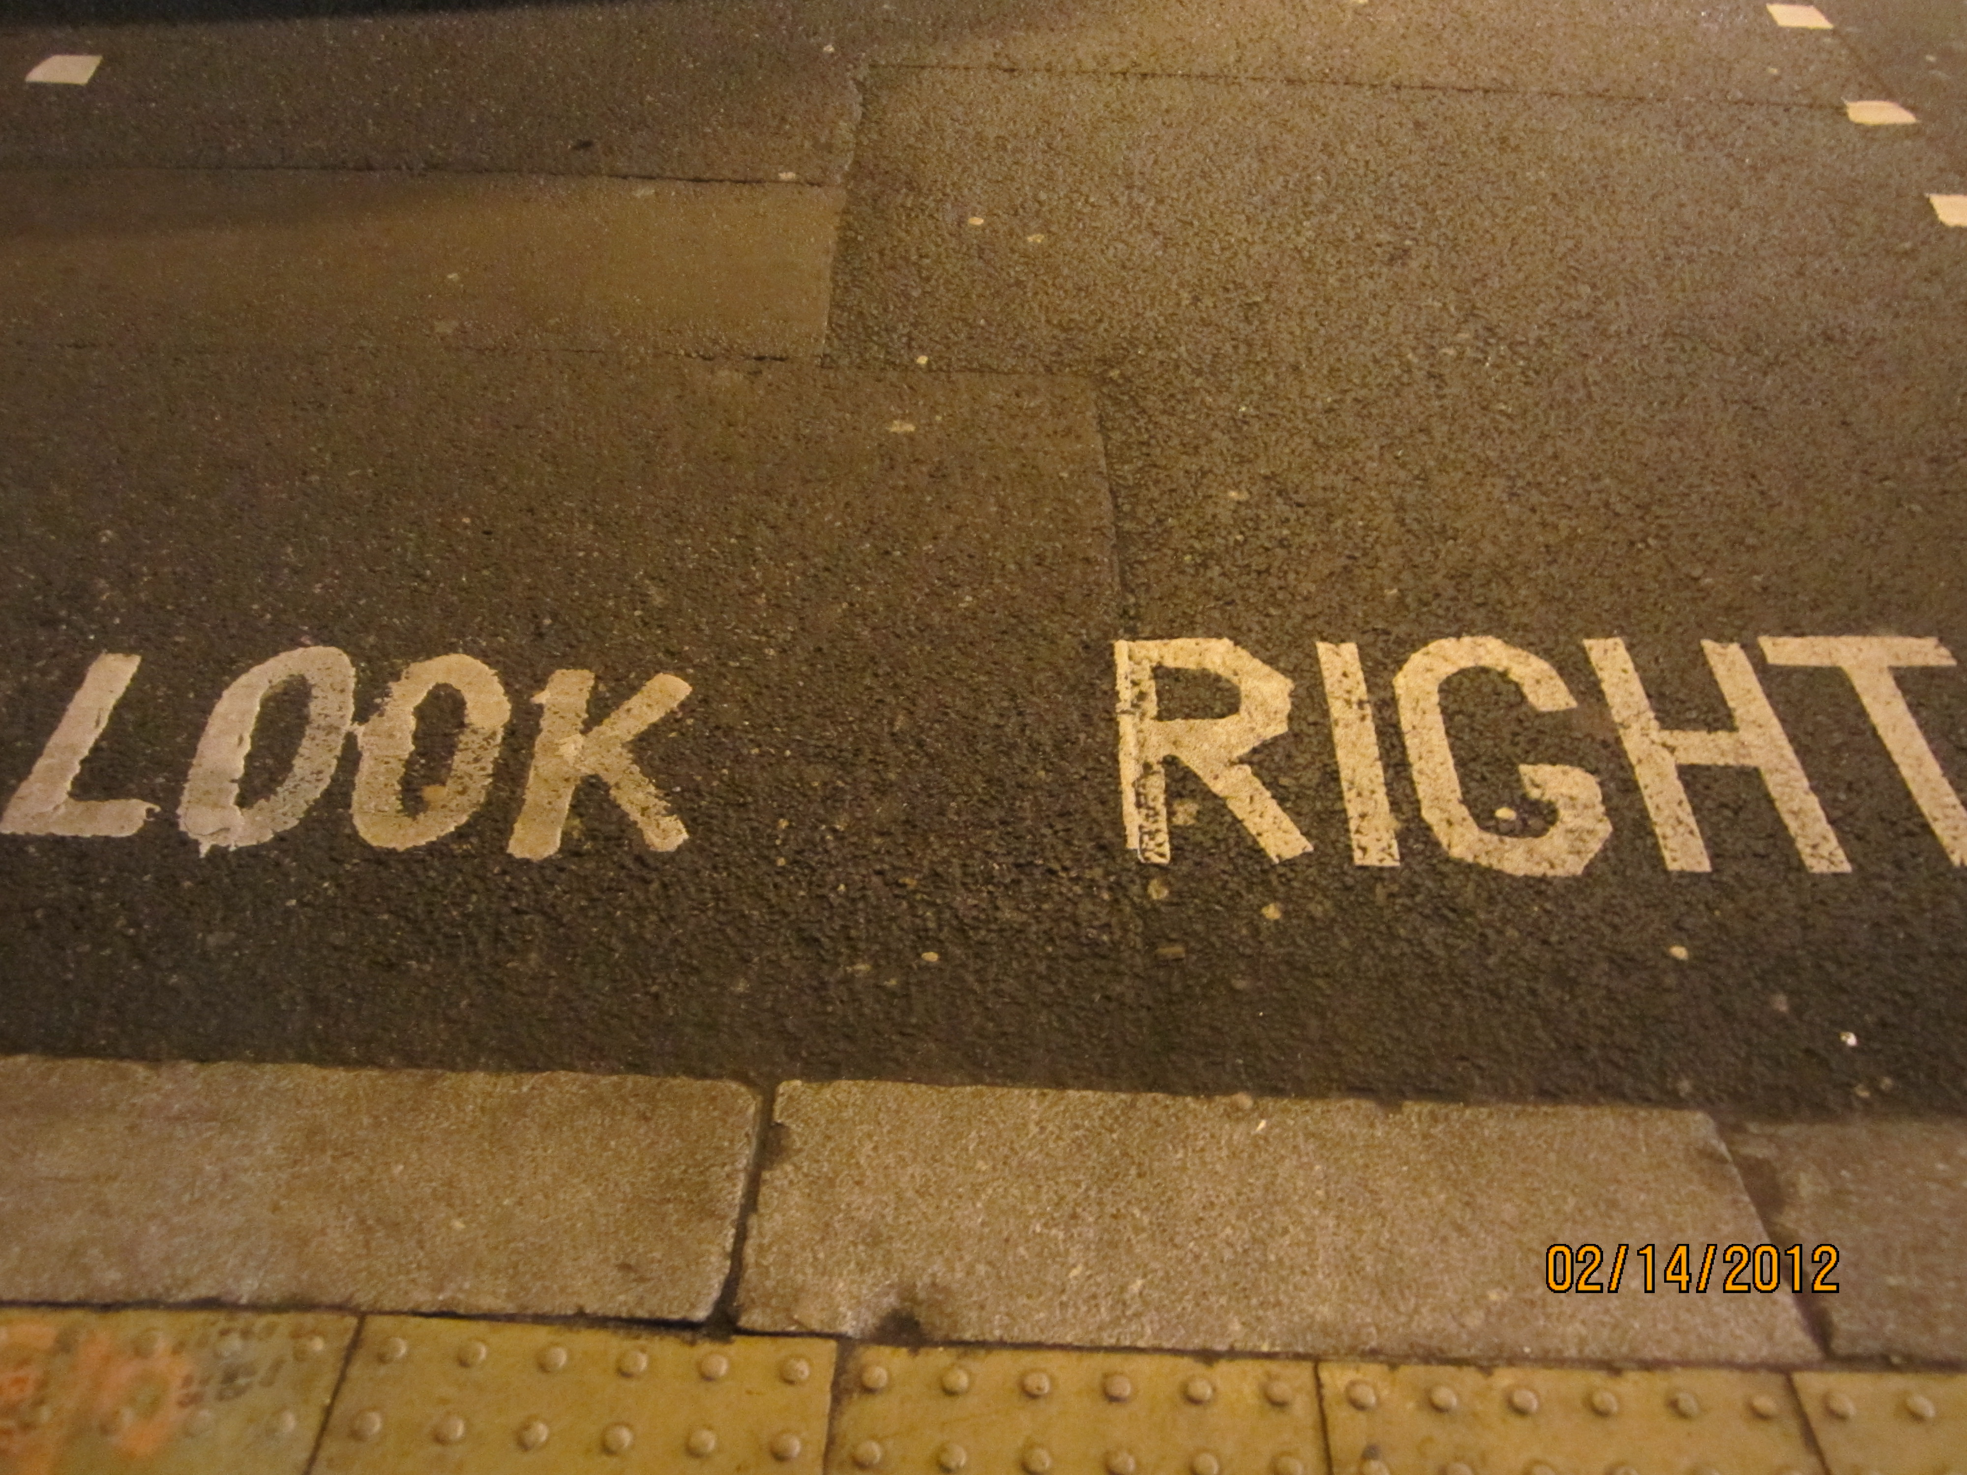

Slide 6
What motivates participation (or non participation)?
Think of a complex and controversial issue in YOUR community that you care about and is important to YOU…but that did NOT get involved in.

Slide 7
How would you define meaningful public engagement?
Multi-way process focused on an outcome or decision
Open, Transparent and Accountable
Clear purpose and focus
Focused on what people (including you) want to talk about and that matters
Is inclusive and includes all who are interested / affected
Builds understanding / informed participation
Is a journey versus an event
Is open to change, possibility and influence
Embraces emotion & supports constructive participation
Builds community, connection & capacity

Slide 8
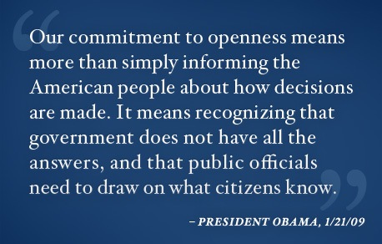
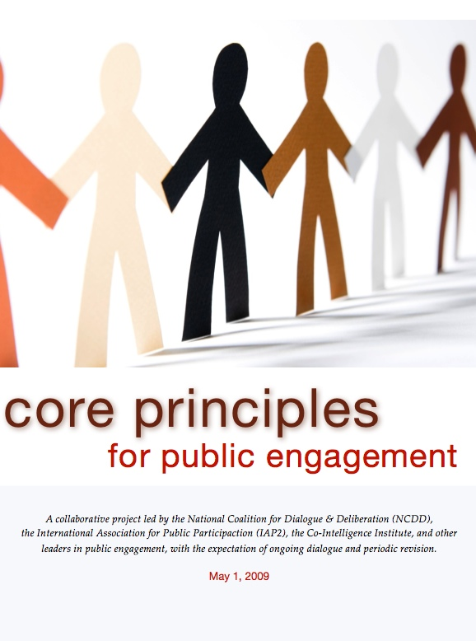
IAP2 Core Values / Guiding Principles for Public Engagement

Slide 9
Persuade or Convince participants of the benefits or value of a given course of action
Make a decision on an issue and then “consult” with the public

Slide 11
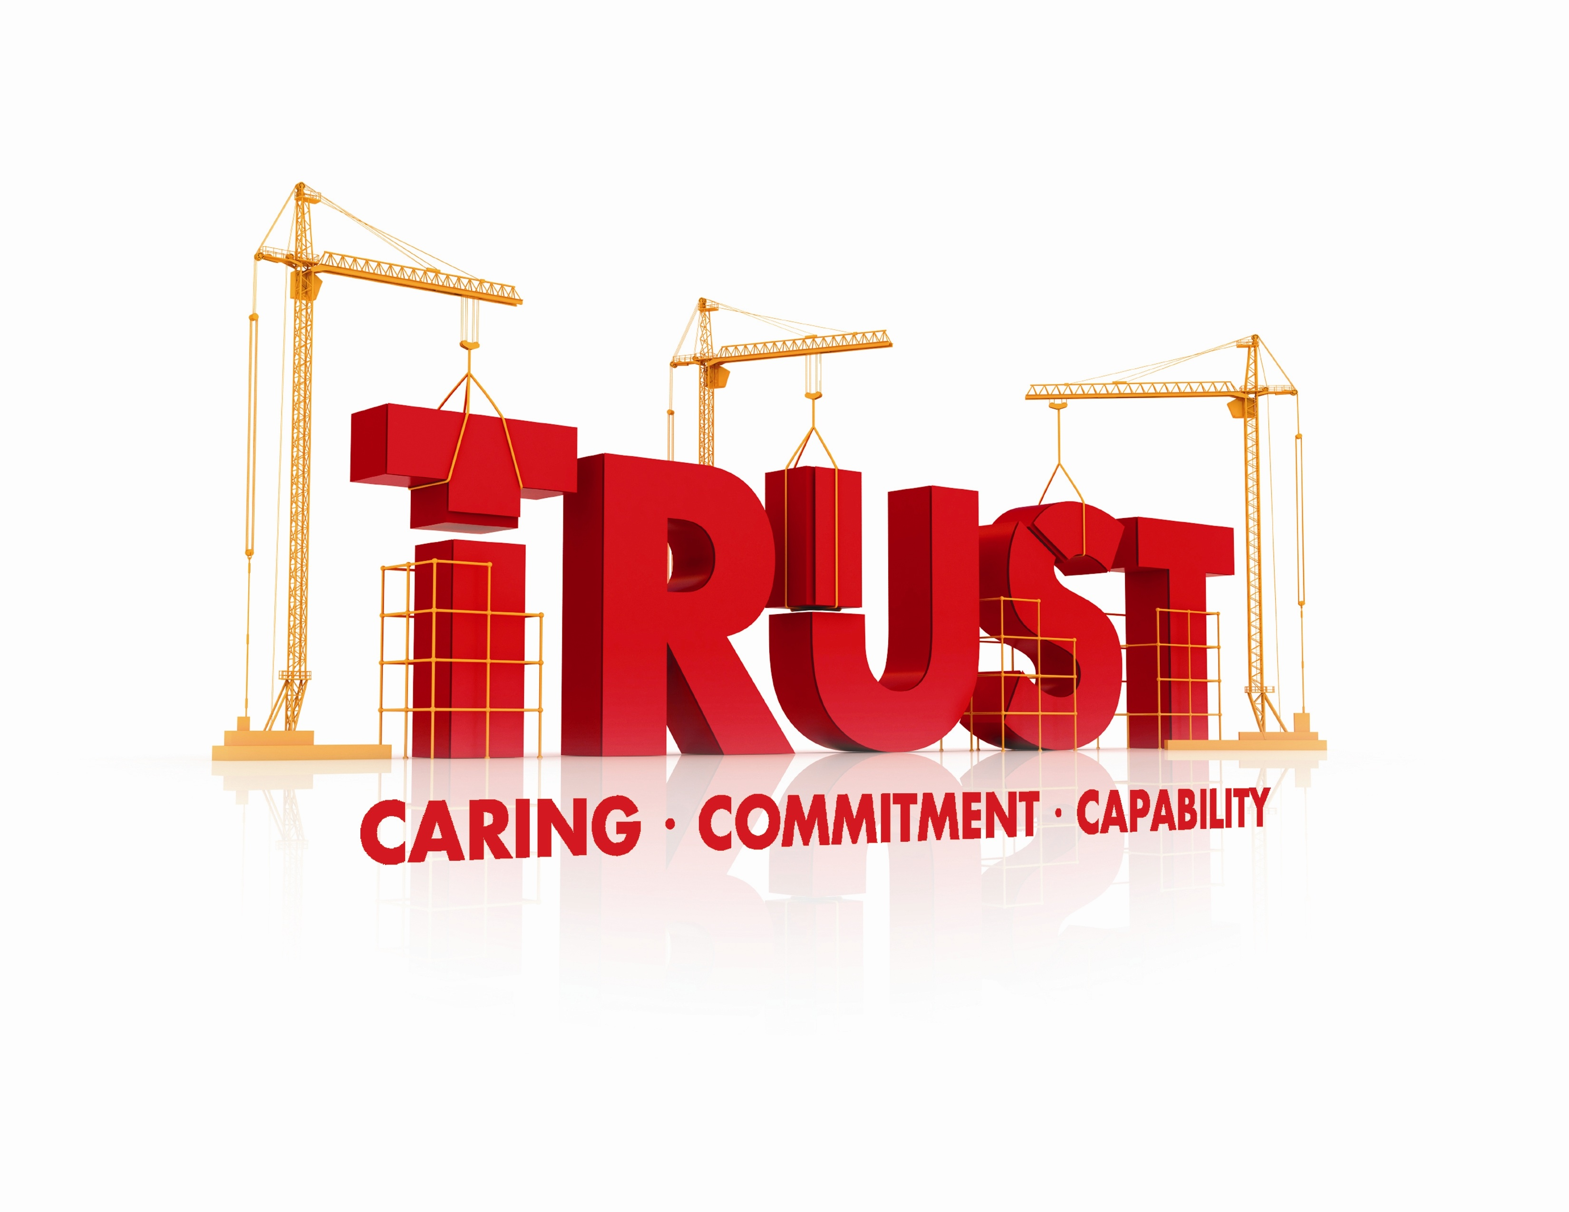

Slide 12
Values based Engagement
Positions
Positions
Interests
Interests
Values
Values
Common Ground
Common Ground

Slide 13
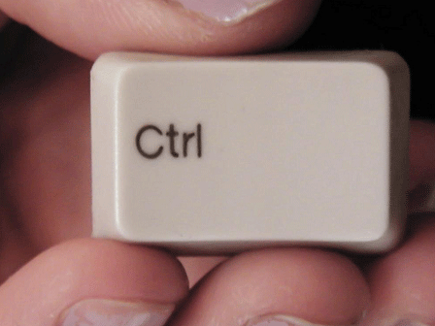

Slide 14
Inclusion AND Representation

Slide 15
Reciprocal Responsibility: Ask MORE of people

Slide 16
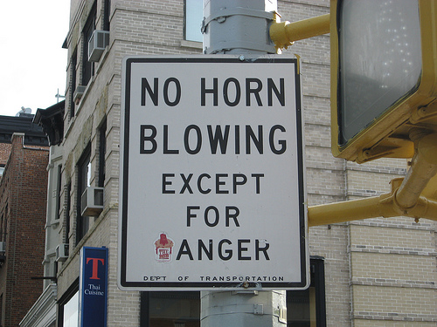

Slide 17
The role of FACTS and INFORMATION in the conversation
The role of EMOTIONS in the conversation

Slide 19
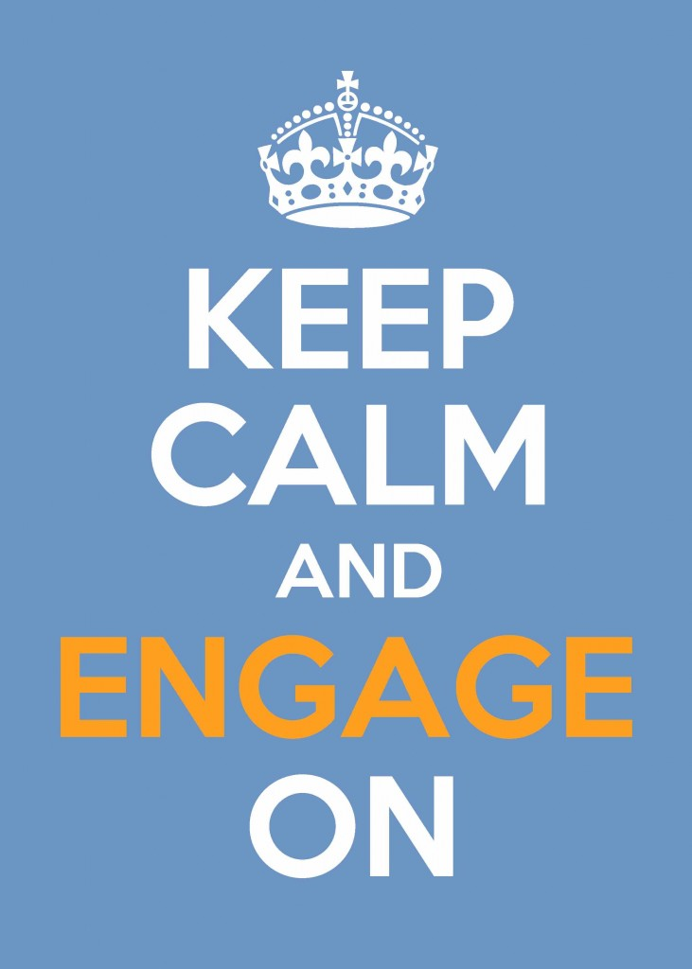

Slide 20
If we are to work together more intelligently, we will need to choose processes that evoke our curiosity, humility, generosity and wisdom.
The ultimate benefit is that we learn that it is good, once again, to work together.
Margaret Wheatley

Slide 21
For more information:
Stephani Roy McCallum
Managing Director
Dialogue Partners Inc.
www.dialoguepartners.ca
stephani@dialoguepartners.ca
613-724-2450 ext 103

